Slide 1

Youth For Restoration
Software Requirement Specification
TEAM 5
FREDERICO CASTRO
GABRIEL MIRANDA
SETHU SUNDARAMOORTHY
CYRIL BARTHELET
IVAN FERNANDES
ZHENKANG YAO
Notes:
[SETHU]
Good evening, We are team 5.
First I’ll introduce the group ( FIRST NAMES ONLY)

Slide 2
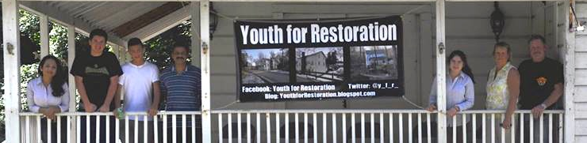
Introduction The Organization
Youth for Restoration is a youth led group located in the Hudson Valley, NY
Goal: preserve and restore local historic sites
Notes:
[SETHU]
- YFR, a group led by Viraj Kumar and a team of Arlington High School students.
- YFR assembles volunteers, raises funds, and contribute manual labor to repair historic sites in the community.
- The group’s first project was in Autumn 2012, when they organized volunteers to clean up and restore the more than 200-year old Quaker cemetery.

Slide 3
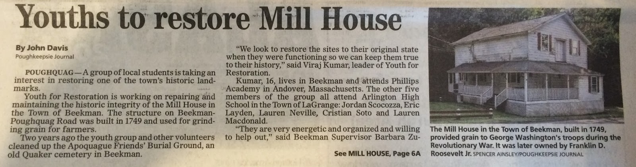
Introduction The Organization
Poughkeepsie Journal on July 28th, 2014
Notes:
[SETHU] The Beekman Mill House, built in 1749 by Robert Livingston was used to grind grain for farmers which was then supplied to the American troops during the Revolutionary War.
FDR Jr. was the last owner of the Mill House before he donated it t the Town of Beekman.
The volunteer group cleaned up the second floor of the Mill House.
Worked on creating a “digital inventory” of the historic tools and other artifacts that are stored in the upper level of the Mill House.
Have worked on an application to have the Mill House placed on the National Register of Historic Places.
[ GABRIEL ]

Slide 4
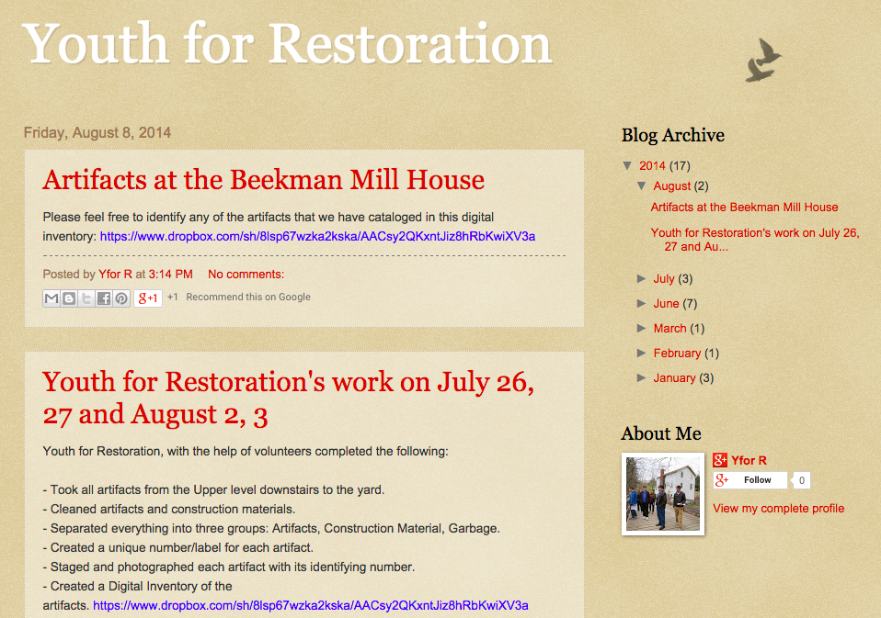
Introduction The Organization
Current Website
Notes:
[ GABRIEL ]
The group’s current website is a blogspot created to provide up-to-date information on the projects.
Group also has a Facebook and Twitter account separately.
We believe that with an improved user experience for the members of the organization may bring more tools to keep the website up to date.

Slide 5
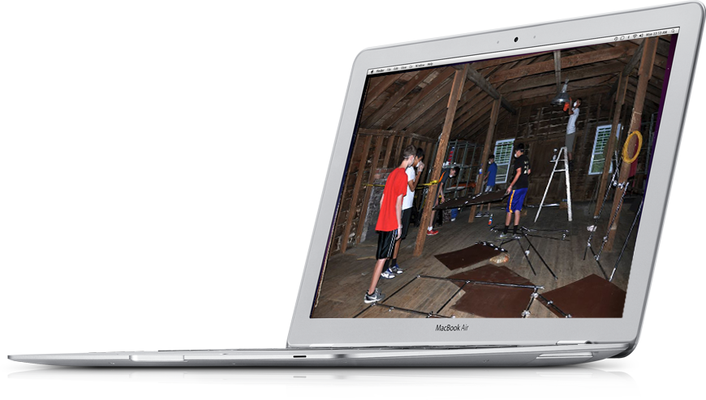
Introduction Scope
Public Website
A website that provides clear and user-friendly experience
It shall encourage the visitors to get engaged in the organization’s cause
Bring visibility to the work
Notes:
[ GABRIEL ]
Our objective is to create a website for the organization that provides clear and user-friendly experience.
The idea is to encourage the visitors to get engaged in the organization's cause.
So, the project will bring two sections: A public one, for visitors and an admin panel.

Slide 6
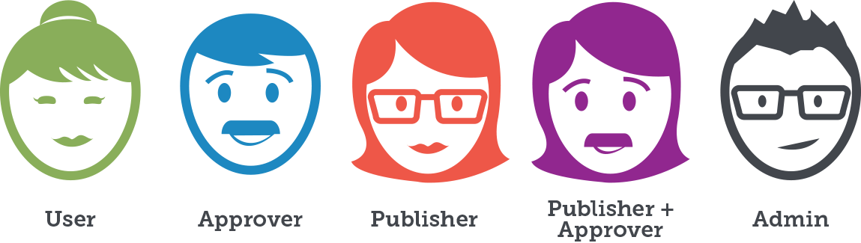
Introduction Scope
2
USER
ROLES
Admin Panel
ADMINISTRATOR
AUTHOR
Notes:
[ GABRIEL ]
The users can have two roles: They either can be an Administrator or an Author.
The author manages blog posts, news and events schedule.
The administrator manages everything that an author manages and also users and website information.

Slide 7

Introduction Scope
Admin Panel
A private section where authors manage content such as blog, news, events schedule.
An environment where administrator manages users, produce content and update website information.
Notes:
[ GABRIEL ]
The website will have an Administration Panel.
It will be a private section where authors can manage content such as blog posts, news, events schedule.
The administrators will be able to manage users, produce content and update website information.
[IVAN]

Slide 8
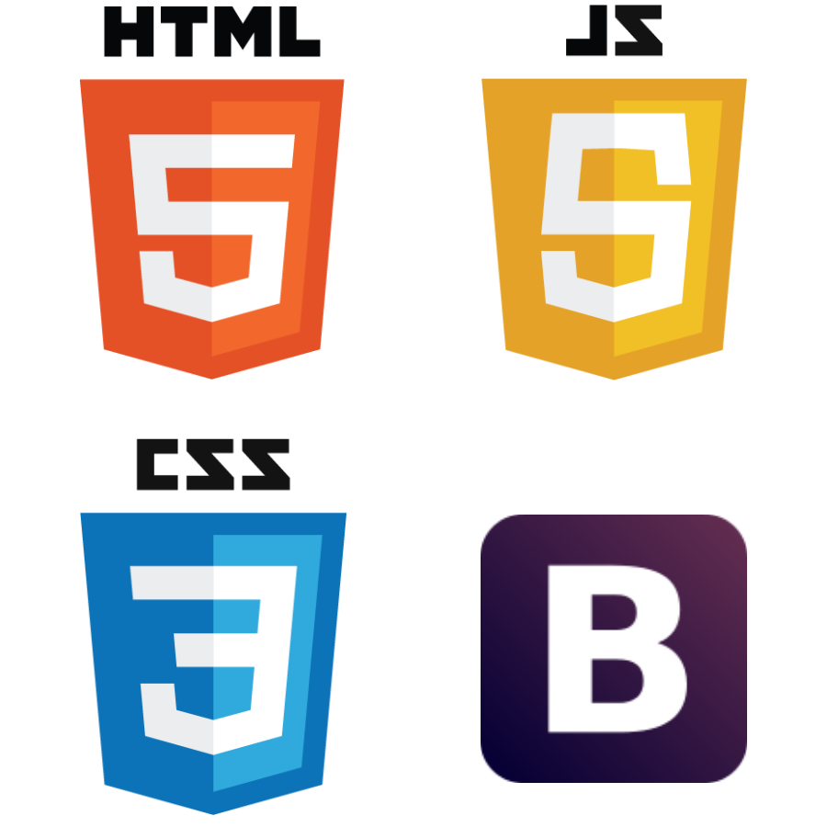

Product Perspective Technologies
Notes:
[ IVAN ]
Technologies used by the website will include HTML 5, JavaScript 5, CSS 3 and Bootstrap with the backend running on PHP

Slide 9
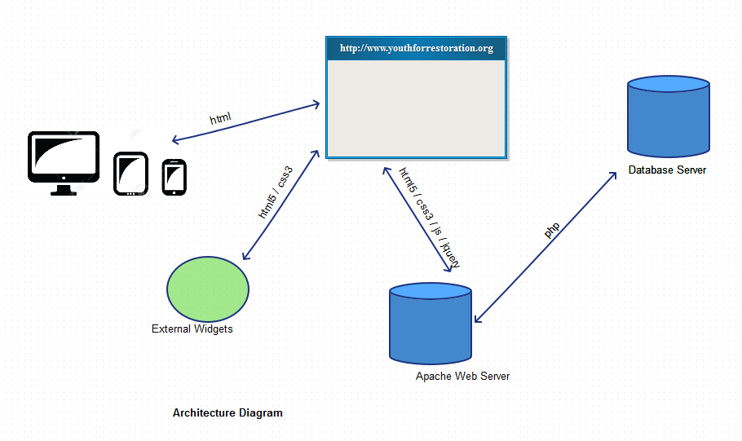

Product Perspective Architecture Diagram
Notes:
[ IVAN ]
This diagram shows how the process of accessing a page works. A request is sent to the Apache Web Server, where the php framework recovers the data from the database system. The php then outputs an html file that is sent by the web server to the client. The client browser receives the html document, get information from external widgets, render the document and executes the embedded javascript code.

Slide 10



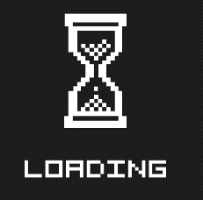
Product Perspective Software Interfaces
Suported Browsers
Minimum | Recommended | Full Support List
Chrome (current version) | Chrome (current version) | Chrome (current version)
Internet Explorer 8 | Internet Explorer 11 | Internet Explorer 8/9/10/11
Firefox (current version) | Firefox (current version) | Firefox (current version)
Safari 5 | Safari 8 | Safari 5/6/7/8
Notes:
[ IVAN ]
These are the supported version of browsers. It’s the main ones: Chrome, Safari, Firefox and … let’s wait for it...

Slide 11

Product Perspective Software Interfaces
Suported Browsers
Minimum | Recommended | Full Support List
Chrome (current version) | Chrome (current version) | Chrome (current version)
Internet Explorer 8 | Internet Explorer 11 | Internet Explorer 8/9/10/11
Firefox (current version) | Firefox (current version) | Firefox (current version)
Safari 5 | Safari 8 | Safari 5/6/7/8
Notes:
[ IVAN ]
There you go, Internet Explorer

Slide 12

Product Perspective Hardware Interfaces
YFR
YFR
YFR
YFR

Slide 13
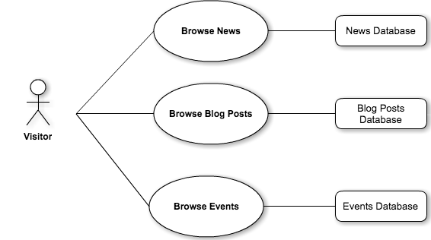
Use Case Diagrams Public Pages
Notes:
[IVAN]
As any modern website our product is going to be portable to different devices and screen size.
Using on the bootstrap framework, the website will provide a reliable and responsive experience allowing users to open the website from pc, tablets and mobile phones.in any of them.
[YAO]

Slide 14
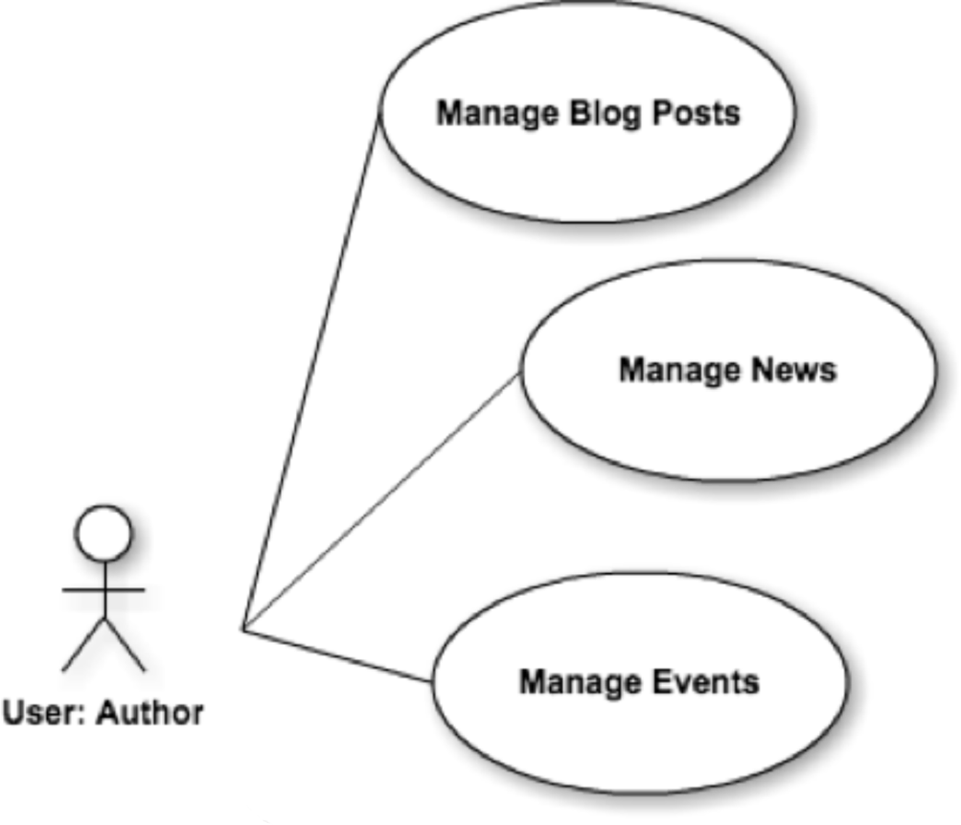
Use Case Diagrams Admin Panel - Author
Notes:
[YAO]
Now the Admin Panel. We have 2 roles for the users.
The first one is the author. An author is a user with the level of authorization for managing the contents of BLOG, NEWS and EVENTS page.
As an author, I can create, list, edit and delete any one of these.
[Authorized access to Admin Panel; Authorized access to Admin Panel; Manage Sponsors, events, news, Blog Posts, Manage Volunteers, Photo Slider contents]

Slide 15
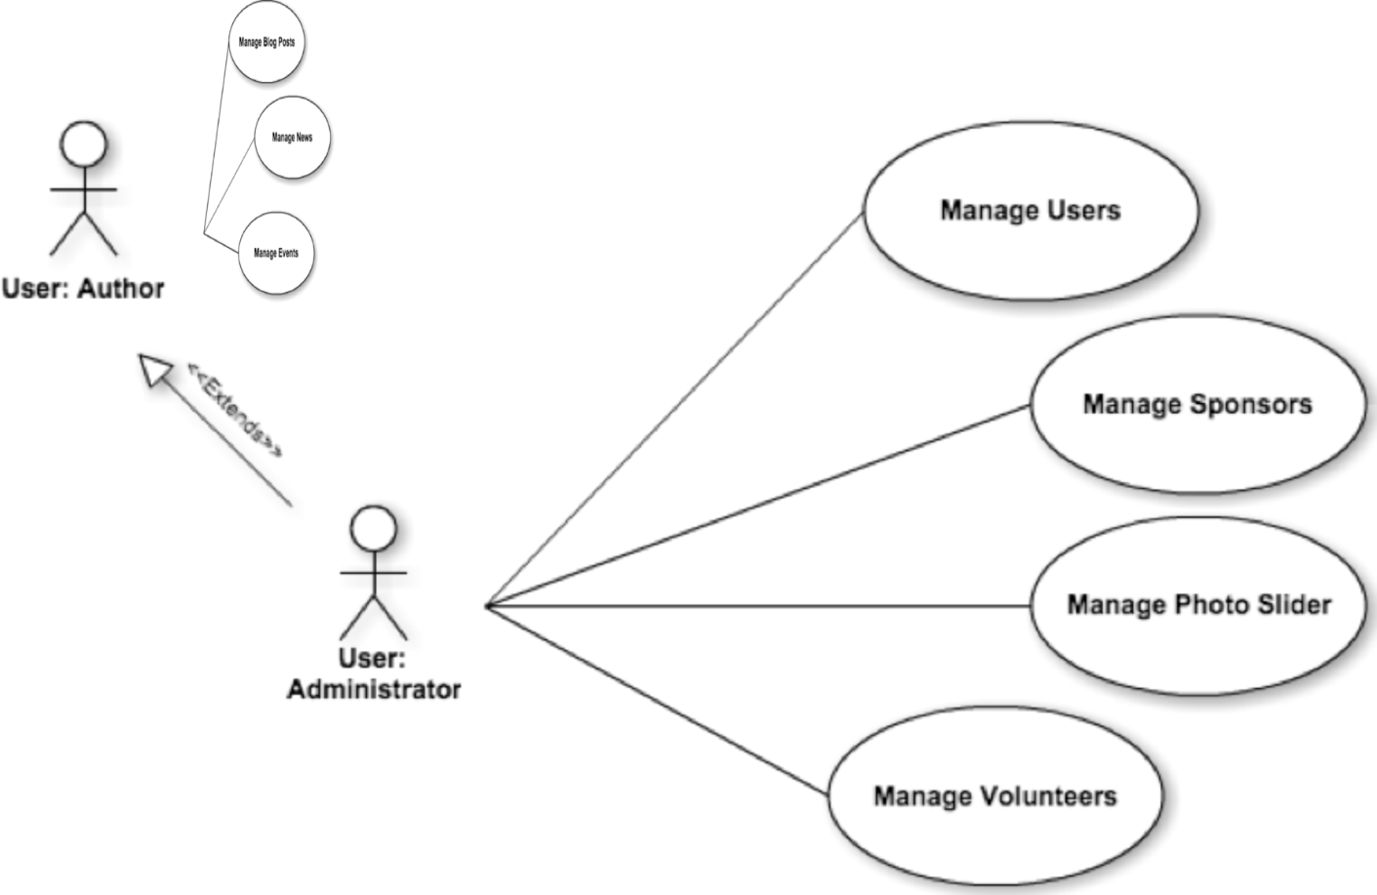
Use Case Diagrams Admin Panel - Administrator
Notes:
[YAO]
Now, We have the high level administrator role.
The administrator may manage the contents that the Author may manage. But he also may manage USERS, SPONSORS, PHOTO SLIDER and VOLUNTEERS sections of the admin panel.
[CYRIL]

Slide 16
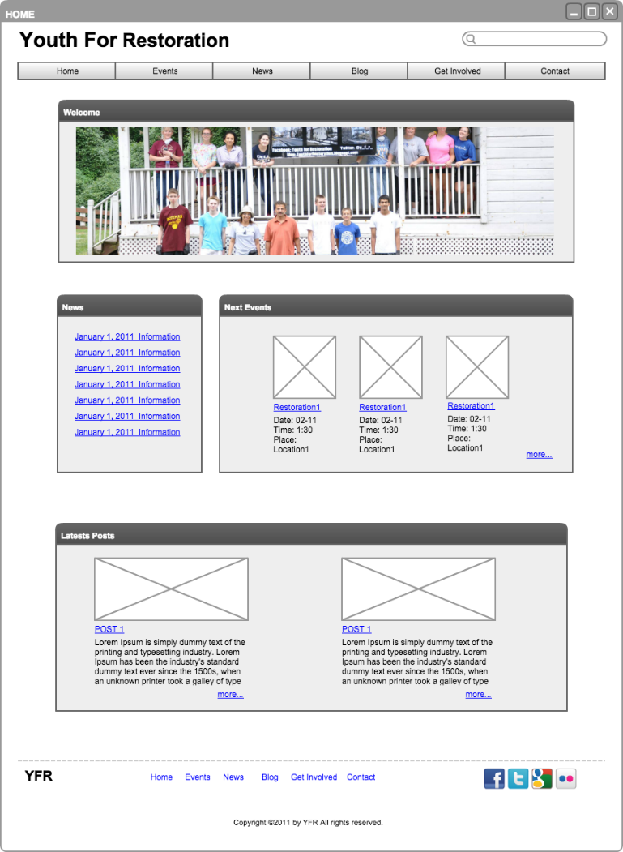
Public Pages Mockups Home Page
Notes:
[ CYRIL ]
Now here are the mockup pages. This is not necessarily the way the website is going to be, but it can help you to get a feel for what it is going to be.

Slide 17
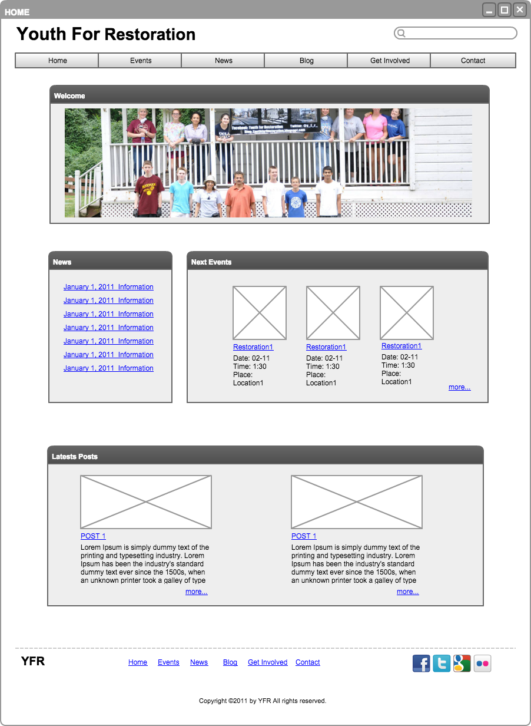
Public Pages Mockups Home Page
Notes:
[ CYRIL ]
The first feature is a photo slider, which administrators may change from time to time.

Slide 18
Public Pages Mockups Home Page
Notes:
[ CYRIL ]
LATEST News and UPCOMING events

Slide 19
Public Pages Mockups Home Page
Notes:
[ CYRIL ]
In the next section we have the Latest Blog posts, with a link to each post and also to the blog page
[KIKO]

Slide 20
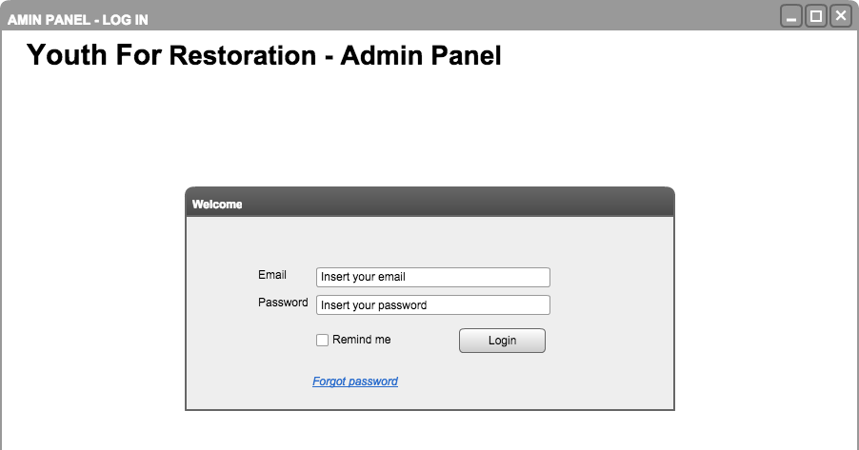
Admin Panel Mockups Login
Notes:
[ KIKO ]
Now, we are going to be talking about the admin panel mockup. Always good to remember, that this is only a reference, not the actual design.
This part of the presentation, we not only may see the mockups, but have some idea of the main use cases.
First things first, in order to have access to the admin panel, the user has to login. This part is only accessible through authentication session.
That is the welcome screen, where the user may insert the login information or if he forgets the password, he may click the Forgot password link. In that case, the system will ask for his email and, if that email is registered in the database, the system will send an email with a new password page link.

Slide 21
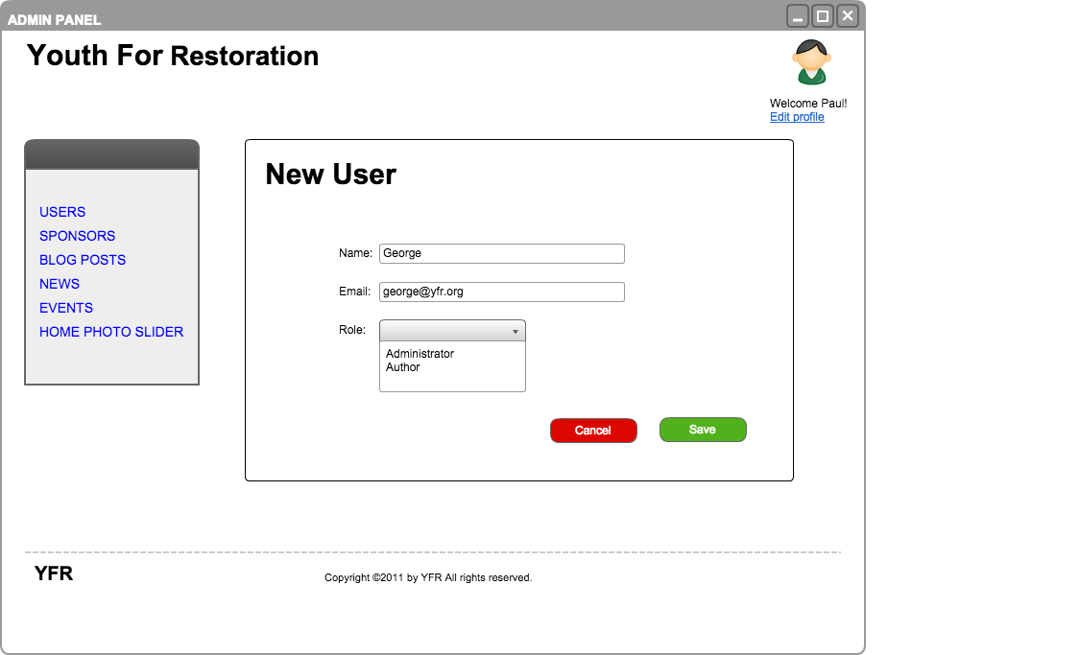
Admin Panel Mockups New User
Notes:
[ KIKO ]
OK! we are in.Now, every page in the admin panel will have a main menu, where the user may find all the links for the information he may have authorization to manage.
In this case, We are logged in as which role? any guess?
Correct! We have the ADMINISTRATOR role. That is the case because only administrators have access to users sponsors and photo slider management.
So this screen shows the new user registration. It is pretty straight forward: Name, email and role. The rest of the information will be editable by each user.

Slide 22
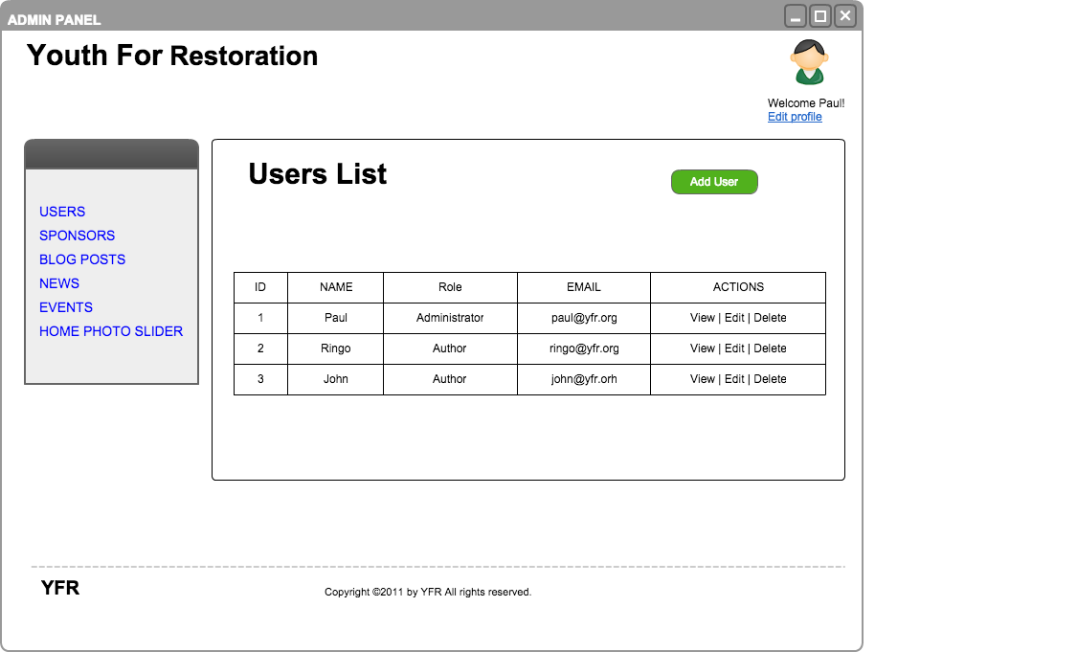
Admin Panel Mockups List Users
Notes:
[ KIKO ]
This is a list of users, so that the administrator may select the user he wants to view or edit. Let's say John is being a nice volunteer to the Youth of Restoration team, and we want to promote him from Author to Administrator, we find him, see there? We click edit number 3. We click aaaand

Slide 23
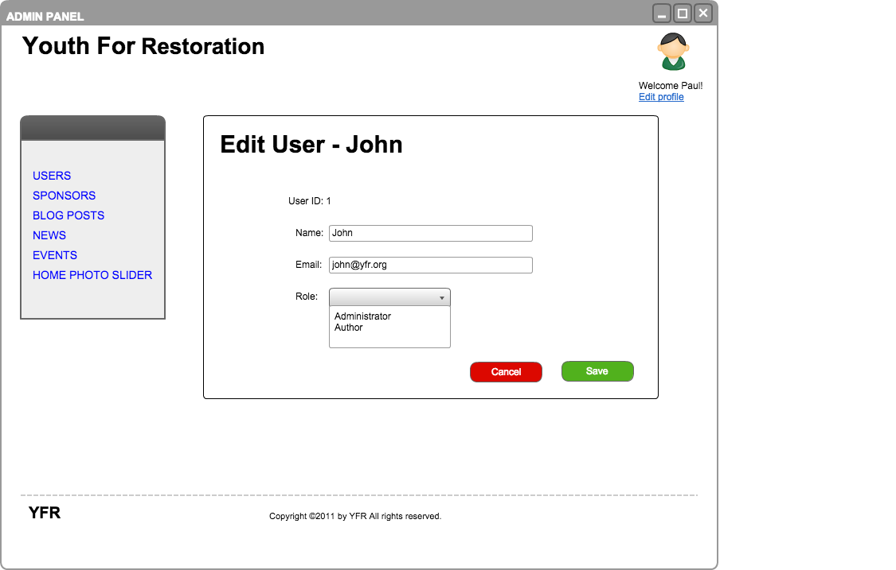
Admin Panel Mockups Edit User
Notes:
[ KIKO ]
There you go, We can change John's role and some other information, if that is necessary.
Ok then, now John wants to change some of his information. It's ok, any user may and should edit his profile.

Slide 24
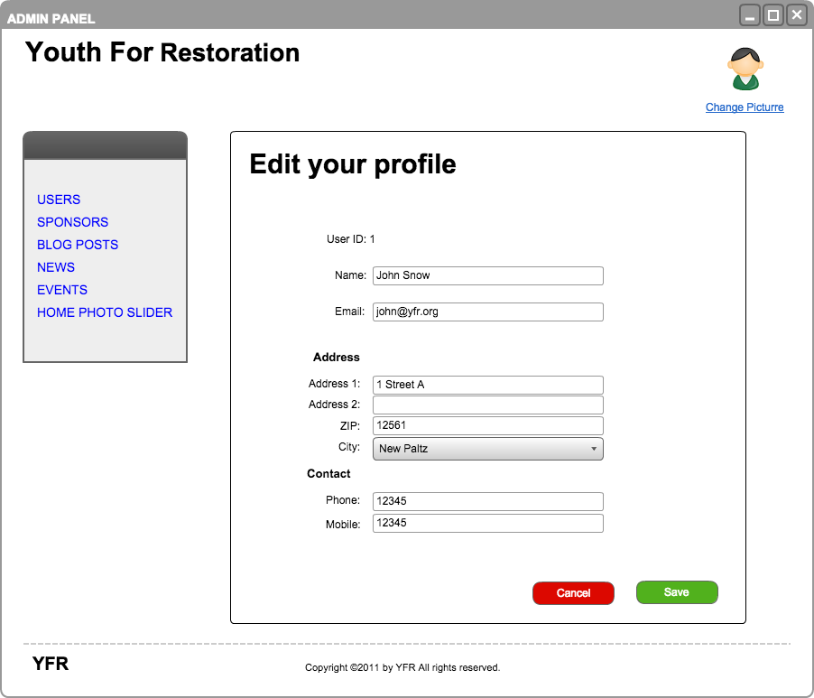
Admin Panel Mockups Edit User Profile
Notes:
[ KIKO ]
Once the Administrator does not need to manage a user information at that level, here we allow each user to insert all his information.
He may also change his picture.

Slide 25
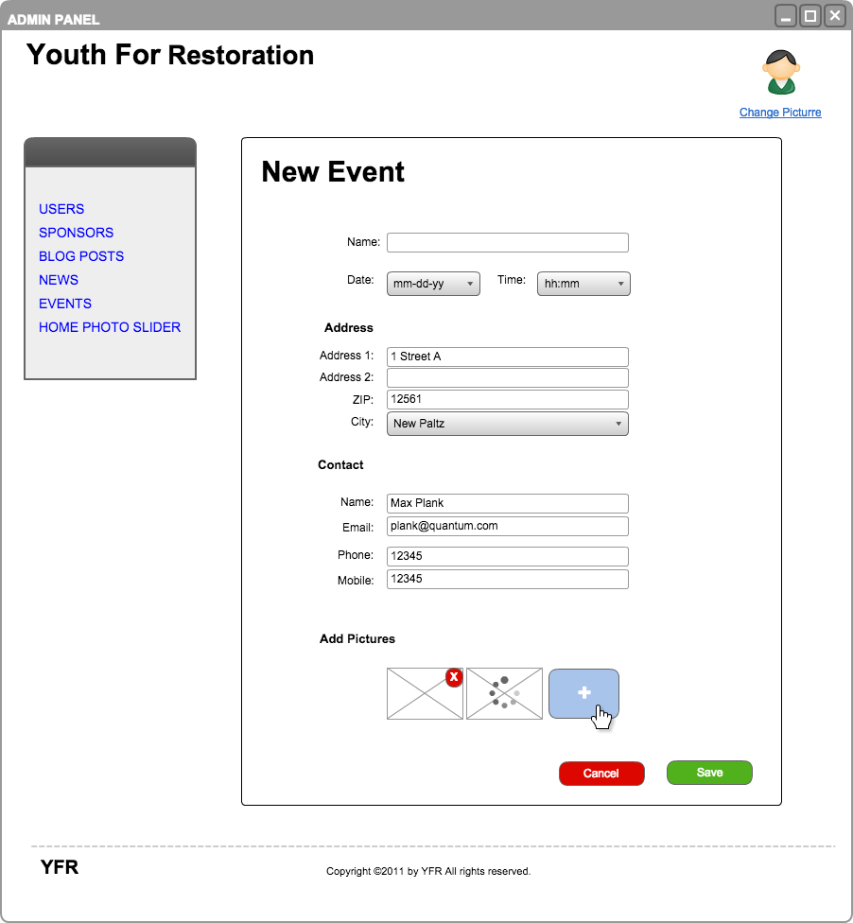
Admin Panel Mockups New Event
Notes:
[ KIKO ]
Here, the New Event form. It has the following sections:

Slide 26
Admin Panel Mockups New Event
Notes:
[ KIKO ]
Main information: Name, Date and Time

Slide 27
Admin Panel Mockups New Event
Notes:
[ KIKO ]
Address, Contact and finally pictures for the event.

Slide 28
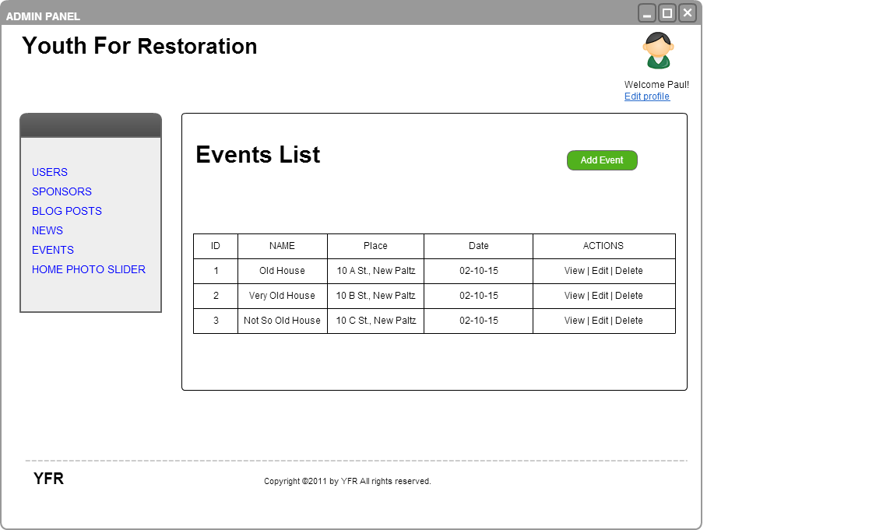
Admin Panel Mockups List Events
Notes:
[ KIKO ]
Here we may list the Events.
Note that on the list table, we don't have to see every attribute of the object.
We only need the main information. All the details come inside

Slide 29
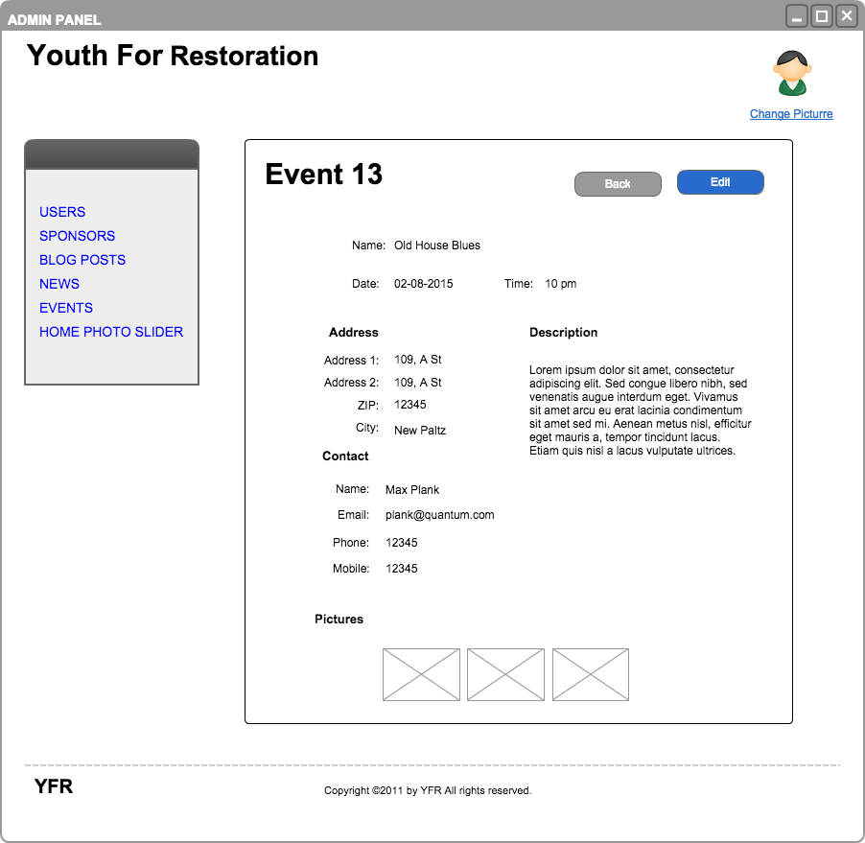
Admin Panel Mockups Show Event
Notes:
[ KIKO ]
After creating, this is how we may see details of one event.
So this is the overview of the Admin panel.

Slide 30
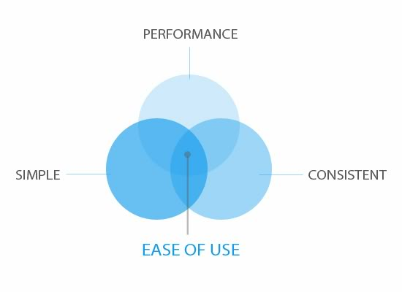
Non-functional Requirements Usability
Quick response time
Intuitive design
Reliability
Unit testing
Scalability
Notes:
[ GABRIEL ]
Now, for the non-functional requirements (READ LIST)
the testing capability and scalability will allow the website to grow. For example, the future versions could have a social network for the organization’s volunteers. (talk about the things a volunteer would be able to do in case there was a social network for him in the website.
[IVAN]

Slide 31


Non-functional Requirements Security
Password security – Advanced Encryption Standard (AES)
Deny access if either user email or password are incorrect
Logout User Session after 30 minutes of Inactivity
Registered Users – Password Recovery
Notes:
[ IVAN ]
Continuing with the non functional requirements <!-- we are going to talk about some of the security features our website will have. -->
We all know how critical information security is on a system that involves authentication.
The system will have the latest technologies in password encryption, deny unauthorized access, logout after inactivity and password recovery
[SETHU]

Slide 32
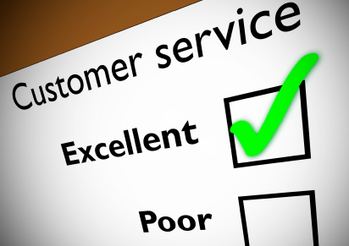
Conclusion Purpose
To build a website that provides consistent and high quality user experience for both the visitors and the administrators
Notes:
[ SETHU ]
To build a website that provides consistent and high quality user experience for both the visitors and the administrators.
both the visitors and the administrators
To conclude, I would like to point you to a quote by Viraj Kumar, leader of YFR from an article published in the Poughkeepsie Journal
Viraj says “Projects like this invigorate the community and allow us to uncover the past while working on the present”.
Our aim is that this website will help carry this vision into the future.

Slide 33
Conclusion Quotation
“Projects like this invigorate the community and allow us to uncover the past while working on the present”
Viraj Kumar
Notes:
To conclude, I would like to point you to a quote by Viraj Kumar, leader of YFR from an article published in the Poughkeepsie Journal
Viraj says “Projects like this invigorate the community and allow us to uncover the past while working on the present”.

Slide 34
Thank You!
TEAM 5

Slide 35

Youth For Restoration
Software Requirement Specification
Let’s get to work…

